Slide 1
Ask Git
Version control system with GIT
Daniel Kwaro, KEMRI-CGHR
25th June 2019

Slide 2
Version control the 'usual way'
There are many ways to track history of files
The most basic is to add systematic suffixes to file names:
main_original.do
main_revised_1.do
main_revised_2.do
and so on...

Slide 3
Version control the 'git way'
Make changes
Take a snapshot of changes
GOTO line 1
Adds ability to :
move to any snapshot in the history of changes
back-up history of changes
collaborate or work remotely

Slide 4
Let's create a story
#create folder to store the story file
#use notebook++ to write a story
Once upon a time_____, and every day_____, until one day_____, and because of that_____ and because of that_____until finally______ and ever since then______.
This is a story about <character>
Once upon a time there lived .....
Everyday,<character did this and that>
One day, <event happened>
And then....
And then....
Finally.......
Ever since

Slide 5
Working alone

Slide 6
Download and configure git application
#download and install git:
https://git-scm.com/downloads
#download and install git GUI client
https://desktop.github.com
https://tortoisegit.org/
or, interact with git through command line
#configure git
git config --global user.name "My Name"
git config --global user.email myEmail@example.com
You might want or be required to use an SSH key:
tutorial by DigitalOcean: https://docs.gitlab.com/ce/ssh/README.html

Slide 7
Create local repository
# open the workspace/directory/folder you want to keep track of
pwd #print/display the current working directory
cd path/to/workspace
# ask git to initialize/create a repository in the current workspace/working directory
git init
#git maintains three local “trees” and synchronizes with remote “tree”
Working directory
Index/stage
Local repository
Remote repository
add
commit
push

Slide 8
Save most up-to-date version of project
# ask git to mark files you would like to register, i.e. add them to the “index/list of staged files”
git add <filename>
# ask git to record/register/save/commit/log the marked/index files into the repository
git commit – m “<message describing the initial snapshot>
#ask git to display/show details of a specific commit/snapshot
git show
*commit refers to both the verb/action of making a snapshot/revising and the noun/snapshot/revision

Slide 9
Make changes to the workspace
#change code in working directory:
Create new file
Modify existing file
change contents
change name/ rename
change location/move
Delete existing file
#ask git to display status of files and folders in workspace
git status

Slide 10
Save new changes made to the workspace
# ask git to mark files you would like to add to stage or list of changes to register later
git add
# ask git to register/commit marked files
git commit
#ask git to display status of all files in the working directory
git status
#ask git to display/show details of the specific commit
git show <commit>
#ask git to display the differences between commits
git diff <commit-from>..<commit-to>

Slide 11
Make and record more changes to the workspace
#change code in working directory:
Create new file
Modify existing file
change contents
change name/ rename
change location/move
Delete existing file
#ask git to record the changes
git add
git commit
#ask git to display status of files and folders in workspace
git status

Slide 12
Check history of changes made to the workspace
#ask git to display the history/log of registered changes
git log
git log --pretty=oneline //see a very compressed log with one line for every commit
git log --graph --oneline --decorate –all //see ASCII art tree of all branches
git log –name-status //see only files which have changed

Slide 13
Inspecting a repository
#to view status of files in working directory and staging area:
git status or git status –s (short version)
#to see what is modified but unstaged:
git diff
#to see a list of staged changes:
git diff --cached
#to see a log of all changes in your local repo:
git log or git log --oneline (shorter version)
git log -2 (to show only the 2 most recent updates)

Slide 14
Create a branch to track “experimental” changes to the workspace
# ask git to create a new feature branch out of the master branch
git branch <feature_x>
#ask git to display the list of branches and indicate current/active branch
git branch
# ask git to switch/checkout to the new branch
git checkout

Slide 15
Make and record more changes in the experimental/feature branch
#change code in working directory:
Create new file
Modify existing file
change contents
change name/ rename
change location/move
Delete existing file
#ask git to record the changes
git add
git commit
#ask git to display status of files and folders in workspace
git status
#compare the two branches
#checkout main
#list files in working directory
#checkout <feature_x>
#list files in working directory

Slide 16
Undo changes on a file
#ask git to display commit history
git log --oneline in your terminal window.
#Copy the commit hash for the second commit in the log: 52f823c then press q to exit the log.
#ask git to reset the specific commit
git revert 52f823c
#ask git to display status of your files
git log //a new commit was created that undoes the changes
git status //the commit was undone and is now an uncommitted change

Slide 17
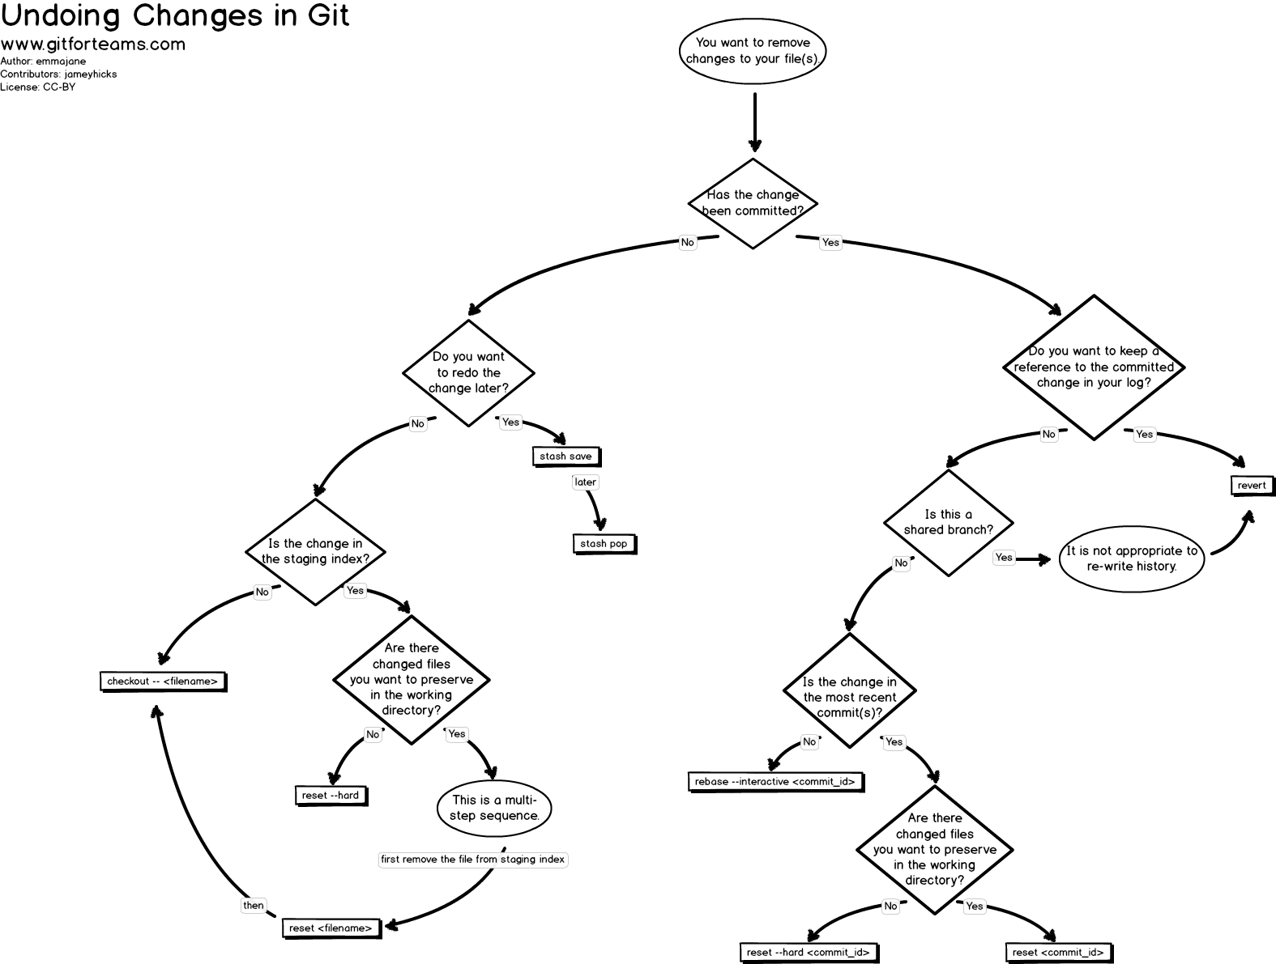

Slide 18
Merge feature branch to the master branch
#ask git to switch/checkout to master branch: git checkout master
#ask git to check whether current/active branch is master: git branch
#check current list of files in master: ls
#preview updates before merging: git diff <source_branch> <target_branch>
#merge feature branch into master branch: git merge <feature_x>
#check current list of files in master branch: ls
#display branching structure
~delete experiemental branch if stale then display branching structure
*never commit to master because master will be the branch that you pull upstream changes from
*Use git pull –rebase to move all of your commits to the tip of the history.

Slide 19
Create remote repo for back up
Introduce yourself to GitHub
#Register on GitHub:
https://github.com/
#Authenticating to GitHub Desktop
https://help.github.com/desktop/guides/gettingstarted/authenticating-to-github/
#Configuring Git for GitHub Desktop
https://help.github.com/desktop/guides/gettingstarted/configuring-git-for-github-desktop/

Slide 20
create online repository to back up your history and work remotely
#configure the remote repo
git remote add origin <link of your central repository>
#Push your local changes to the remote repo.
#Pull from remote repo to get most recent changes.
– (fix conflicts if necessary, add/commit them to your local repo)
#To fetch the most recent updates from the remote repo into
your local repo, and put them into your working directory:
– git pull origin master
#To put your changes from your local repo in the remote repo:
– git push origin master

Slide 21
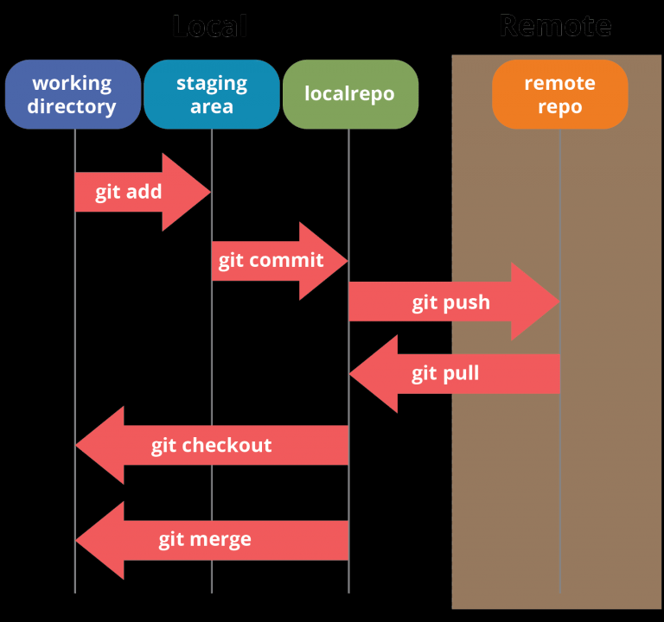
source: https://www.edureka.co/blog/git-tutorial/

Slide 22
Summary of individual work –initialize. ((code-stage-&-commit)⁺. pull rebase.push)⁺
Create/initialize local repo to trace history of your work (i.e. git init)
Start from master branch
Stage and commit current uptodate files if available(i.e. git add, git commit)
Branch out from master to feature branch - for registering new changes (i.e. git branch, git checkout)
Make, stage, and commit changes in feature branch (i.e. git add, git commit).
Merge feature branch into the master branch (i.e. git merge)
Delete stale feature branch
Sync with online repo (i.e. git pull, git push)
Git pull: fetch from a remote repo and try to merge into the current branch
Git push : push your new branches and data to a remote repository
Pick a local repo→take snapshot of current work →make changes → record changes→ synchronize with remote repository

Slide 23
Working in a team

Slide 24
Create online copy of main repository then download
#fork existing central online repository
Forked is nothing more than a server side git clone
#download forked repository to local machine
pwd #print/display the current working directory
cd path/to/workspace
git clone /path/to/forked-repository
#git maintains three local “trees” and synchronizes with remote “tree”
Working directory
Index/stage
Local repository
Remote repository
add
commit
push

Slide 25
team repository managed by senior data manager (bare repository)
forked remote repository for data manager 1
forked remote repository for data manager 2
local repository for data manager 1
local repository for data manager2

Slide 26
Create a branch to track “experimental” changes to the workspace
# ask git to create a new feature branch out of the master branch
git branch <feature_x>
#ask git to display the list of branches and indicate current/active branch
git branch
# ask git to switch/checkout to the new branch
git checkout

Slide 27
Make and record more changes in the experimental/feature branch
#change code in working directory:
Create new file
Modify existing file
change contents
change name/ rename
change location/move
Delete existing file
#ask git to record the changes
git add
git commit
#ask git to display status of files and folders in workspace
git status
#compare the two branches
git checkout main
#list files in working directory
git checkout <feature_x>
#list files in working directory

Slide 28
Merge feature branch to the master branch
#ask git to switch/checkout to master branch: git checkout master
#ask git to check whether current/active branch is master: git branch
#check current list of files in master: ls
#preview updates before merging: git diff <source_branch> <target_branch>
#merge feature branch into master branch: git merge <feature_x>
#check current list of files in master branch: ls
#display branching structure
~delete experiemental branch if stale then display branching structure
*never commit to master because master will be the branch that you pull upstream changes from
*Use git pull –rebase to move all of your commits to the tip of the history.

Slide 29
Asking git for information
#to view status of files in working directory and staging area:
git status or git status –s (short version)
#to see what is modified but unstaged:
git diff
#to see a list of staged changes:
git diff --cached
#to see a log of all changes in your local repo:
git log or git log --oneline (shorter version)
git log -2 (to show only the 2 most recent updates)

Slide 30
Synchronize remote and local repository
#Push your local changes to the remote repo.
#Pull from remote repo to get most recent changes.
– (fix conflicts if necessary, add/commit them to your local repo)
#To fetch the most recent updates from the remote repo into
your local repo, and put them into your working directory:
– git pull origin master
#To put your changes from your local repo in the remote repo:
– git push origin master

Slide 31
Handle conflicts during merging
The conflicting file will contain <<< and >>> sections to indicate where git was unable to resolve a conflict:
<<<<<<< HEAD:index.html
<div id="footer">todo: message here</div>
=======
<div id="footer">
thanks for visiting our site
</div>
>>>>>>> SpecialBranch:index.html
Find all such sections, and edit them to the proper state (whichever of the two versions is newer / better / more correct)
When done, stage then commit before merging then uploading
Branch 1 version
Branch 2 version

Slide 32
Handle conflicts during merging
#ask git to fetch updates from remote repository and display downloaded branches
git fetch origin
#ask git to display log of commits in remote master branch
git log --oneline master..origin/master
#ask git to switch to master branch
git checkout master
#ask git to merge changes from remote master
git merge origin/master
#git fetch then git rebase is better than git fetch then git merge

Slide 33
Request senior data manager to review and accept your work
Pull Requests initiate discussion about your commits. Pull Requests also provide a way to notify project maintainers about the changes you'd like them to consider
On GitHub, go to the repository from which you would like to propose changes...team repository
In the “Branch” menu, choose the branch that contains your commits
To the left of the “Branch” menu, click the green Compare and Review button
The Compare page will automatically select the base and compare branches; to change these, click edit
Click Create pull request. Title and describe your pull request. Create pull request
Proposed changes will be merged from the head branch to the base branch that was specified in the pull request
https://help.github.com/en/articles/creating-a-pull-request-from-a-fork
https://help.github.com/en/articles/merging-a-pull-request

Slide 34
Summary of teamwork –fork. clone. ((code-stage-&-commit)⁺. rebase. push.pull request)⁺
Create online repo to back up your work
Clone the repo (i.e. git clone)
Start from master branch
Stage and commit current uptodate files if available(i.e. git add, git commit)
Branch out from master to feature branch - for registering new changes (i.e. git branch, git checkout)
Make, stage, and commit changes. (i.e. git add, git commit).
Merge feature branch into the master branch (i.e. git merge)
Delete stale feature branch
Sync with online repo (i.e. git pull – rebase origin master, git push origin master)
forking gives a "clean" environment
pull requests give a nice way to discuss code

Slide 35
Asking git for help
#get help info about a particular command git help [command]
git help stash

Slide 36
Questions

Slide 37
Thank You!

